Slide 1
SQL Crash Course
Hosted by: Engineering Service Learning
Presented by: Eduardo Hernandez

Slide 2
Learning Goals and Outcomes
My goal is to teach enough about SQL to get started and start pursuing knowledge and projects related independently
Intended for students interested in Data Analytics fields who can’t take a course related to Databases

Slide 3
What’s Not Covered
Connecting a database to a website
Application of a database (With an interface)
Cleaning data
Database Security (Authentication and such)

Slide 4
The Data
Databases store their data in tables
Tables consist of Rows and Columns
Rows are the entries
Columns are the attributes

Slide 5
Statements
CREATE TABLE <table name> ( );
INSERT INTO <table name >( ) values ( );
UPDATE<table name>
SET <column> = <value>
[WHERE <some_column> = <some_value>]
DELETE FROM <table name> WHERE “ “
SELECT <column>
FROM <table>
WHERE <some_column> = <some_value>
GROUP BY/ORDER BY <column>

Slide 6
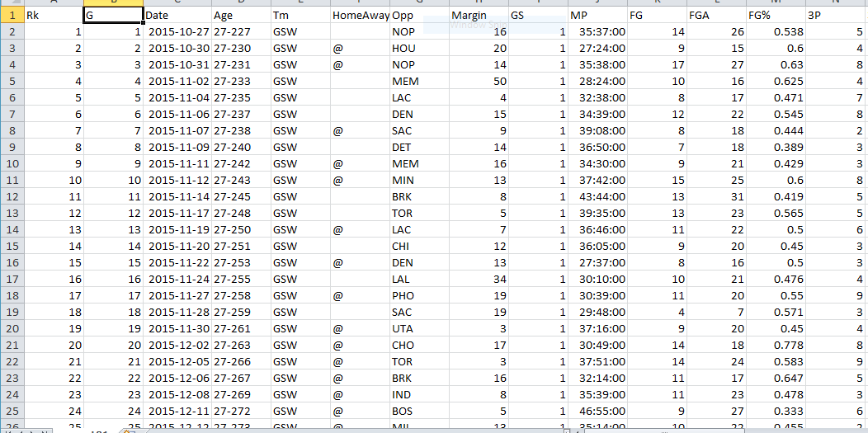
The Dataset
http://www.basketball-reference.com/

Slide 7
We must define the schema
For each player’s data this includes age, team, minutes played, field goals, field goals attempted, three pointers, three pointers attempted, free throws, free throws attempted, assists, steals, blocks, turnovers, personal fouls, total points
In our dataset this includes over 30 attributes for each player, for each game they played in!

Slide 8
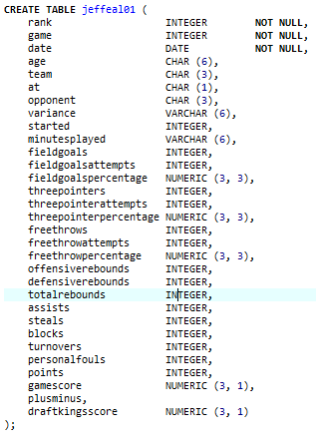
We must define the schema

Slide 9
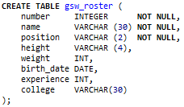
We must define the schema
Let’s use create a table for team rosters instead!

Slide 10
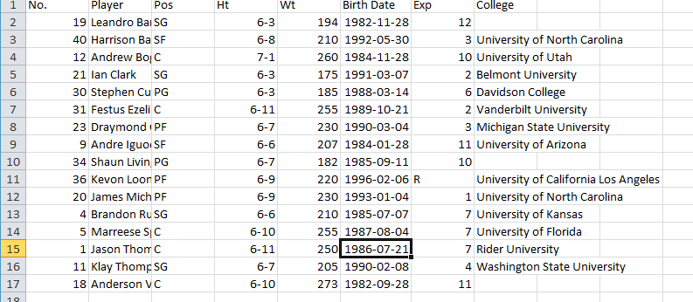
Team Roster Dataset

Slide 11
Attribute Datatypes
Char ( )
Varchar ( )
Integer
Numeric (or Decimal) ( )
Date

Slide 12
Char ( )
Can be character strings of fixed length
Length is defined in the parenthesis
Strings too short will have empty spaces
Ex: Char (3)
Valid Input:
‘abc’
‘ab’
‘123’
Invalid Input:
‘abcd’
123

Slide 13
Varchar ( )
Can be character strings of variable length
Length is defined in the parenthesis
Ex: Varchar (3)
Valid Input:
‘abc’
‘ab’
‘123’
Invalid Input:
‘abcd’
123

Slide 14
Integer
Can be character strings of fixed length
Length is defined in the parenthesis
Ex: Integer
Valid Input:
1000
43124
-4312
3.14 (becomes 3)
Invalid Input:
Numbers too big (out of range)
1,025,234,000,367

Slide 15
Numeric ( ) (or Decimal ( ))
Can be character strings of fixed length
Length is defined in the parenthesis
Ex: Numeric (10, 3)
Valid Input:
1234567.123
1234567.1234
-1234567.123
-1234567.1234
Invalid Input:
12345678
12345678.12
-12345678.123

Slide 16
Date ( )
Can be character strings of fixed length
Length is defined in the parenthesis
Ex: Date
Valid Input:
‘2016-09-21’
Invalid Input:
November 21, 2016
2016-09-21

Slide 17
More on Datatypes
http://www.cs.toronto.edu/~nn/csc309-20085/guide/pointbase/docs/html/htmlfiles/dev_datatypesandconversionsFIN.html

Slide 18
More Resources
http://www.tutorialspoint.com/sql/
http://www.w3schools.com/sql/default.asp

Slide 19
Homework
Download and Install SQLite and SQLiteStudio on your personal machine
http://www.sqlite.org/
http://sqlitestudio.one.pl/index.rvt
Play around with the interface and run the same scripts we used today

Slide 20
Next Week
I will cover queries (Selection commands)
More food!

Slide 21
Queries
Which employees have last name ‘Smith’?
What are the IDs of every employee older than 30 years old?
What are the names of all the employees?

Slide 22
Advanced Queries
How many employees don’t live in Arizona?
What’s the sum of every employees’ ages?
What city do the most employees live in?
What’s the name of the oldest employee?

